Slide 1

Department of Computer Science & Engineering
UNIVERSITY OF MINES AND TECHNOLOGY
ADVANCED DATABASE
CE 280
Presented BY: DR Eric affum

Slide 2
Stored Procedures
A stored procedure is a prepared SQL code that can be saved, so the code can be reused over and over again.
T-SQL statements that are stored in the database. Instead of having to issues multiple statements from your application you can issue one command to call the stored procedure to do a batch of work instead of just one statement.

Slide 3
Stored Procedures
Used in cases of frequently written;
Can act based on the parameters passed to them
Syntax for creating a SP:
CREATE PROCEDURE procedure_name AS sql_statement GO;

Slide 4
Stored Procedures
Syntax for Executing an SP:
EXEC procedure_name;

Slide 5
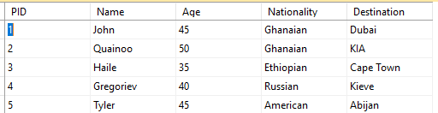
Stored Procedures
Consider the Table below:

Slide 6
Stored Procedures
A query to fetch names of pilots, their nationalities and flight destinations can be written as follows:
SELECT Name, Nationality,Destination
FROM Pilot
ORDER BY
Name;
This can be reorganized into a stored procedure as shown on next slide

Slide 7
Stored Procedures
CREATE PROCEDURE firstProcedure
AS
BEGIN
SELECT Name, Nationality,Destination
FROM Pilot
ORDER BY
Name;
END
GO
Call the procedure:
EXEC firstProcedure

Slide 8
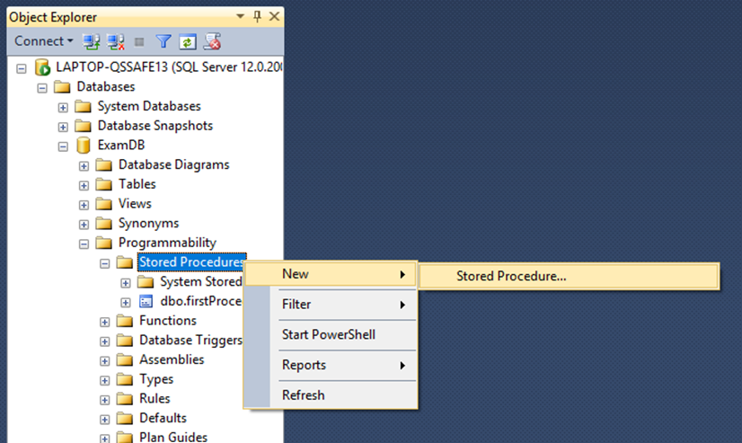
Writing Stored Procedures in MS SQL Server

Slide 9
Stored Procedures with Parameters
Procedures can be written to allow users to specify values or make choices when calling the procedures.
To do this, we must specify one or more parameters
This is generalised as follows:
CREATE PROCEDURE procedure_name(@P1, @P2, . . .,@pn) AS sql_statement GO

Slide 10
Example 1: Single Parameter
CREATE PROCEDURE firstParamProcedure(@choiceAge as Integer)
AS
BEGIN
SELECT
Name, Nationality, Age
FROM Pilot
WHERE
Age <= @choiceAge
ORDER BY
Name;
END
GO
Call the procedure:
EXEC firstParamProcedure @choiceAge =45

Slide 11
Example 2: Multiple parameters
CREATE PROCEDURE MoreParam(@choiceAge as Integer, @citizen as Varchar)
AS
BEGIN
SELECT
Name, Nationality, Age
FROM Pilot
WHERE
Age <= @choiceAge AND Nationality=@citizen
ORDER BY
Name;
END
GO
Call the procedure:
EXEC MoreParam @choiceAge=45, @citizen='Ghanaian'

Slide 12
Example 4: Deleting Data
CREATE PROCEDURE delete_Pilot
@PID int
AS
BEGIN
SET NOCOUNT ON;
delete FROM Pilot
where @PID=PID;
END

Slide 13
SQL Variables and Variable Declaration
Variables are used in SQL statements for the purpose of holding data in various situations.
Every variable must be declared with the right data type.

Slide 14
SQL Variables
MS SQL has two types of variables:
Local variable
Global variable.
However, the user can only create a local variable.
Every local variable scope has the restriction to the current procedure within any given session.

Slide 15
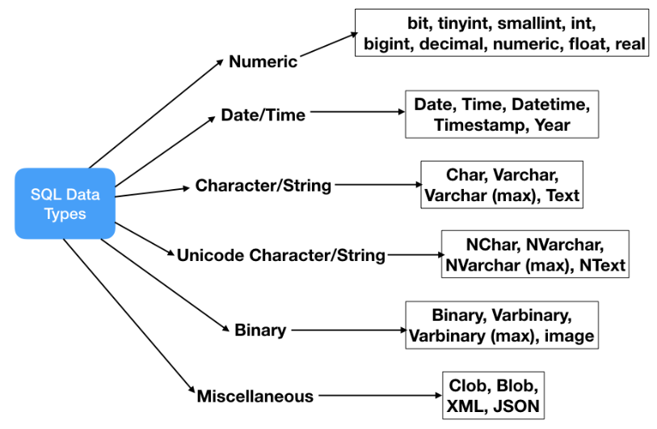
SQL Variables and Variable Declaration

Slide 16
SQL Variables and Variable Declaration
By default, when a variable is declared, its value is set to NULL.
The variable name must start with the @ sign.
Between the variable name and data type, you can use the optional AS keyword as follows:

Slide 17
SQL Variables and Variable Declaration
DECLARE @variable_Name DATATYPE
DECLARE @myAge SMALLINT;
DECLARE @myAge As SMALLINT;
SET @myAge =28;

Slide 18
Use of Variables in SQL server
As a loop counter to count the number of times a loop is performed.
To hold a value to be tested by a control-of-flow statement such as WHILE.
To store the value returned by a stored procedure or a function

Slide 19
Declaring Variables
To declare multiple variables, you separate variables by commas:
DECLARE @model_year SMALLINT,
@product_name VARCHAR(MAX);

Slide 20
SQL Variables and Variable Declaration
DECLARE @myAge AS SMALLINT;
SET @myAge = 35;
SELECT Name, Age, Nationality, Destination
FROM Pilot
WHERE
Age = @myAge
ORDER BY
Name;

Slide 21
SQL Variables and Variable Declaration
Storing query result in a variable
DECLARE @Total INT;
SET @Total =(SELECT
COUNT(*)
FROM Pilot
WHERE
Nationality='Ghanaian'
);
PRINT @Total;
:

Slide 22
SQL Variables and Variable Declaration
Selecting Records into variable
DECLARE
@pilotName As VARCHAR(25),
@pilotNationality As VARCHAR(25);
SELECT
@pilotName = Name,
@pilotNationality = Nationality
FROM Pilot
WHERE
Nationality = 'Ghanaian';
PRINT @pilotName
PRINT @pilotNationality

Slide 23
IF-ELSE Statements
Structure of a simple if statement
IF boolean_expression
BEGIN
statement_block
END

Slide 24
IF-ELSE Statements
Simple if Example
DECLARE
@pilotAge As int
SELECT
@pilotAge = Age
FROM Pilot
WHERE
Nationality = 'Ghanaian';
IF @pilotAge <50
BEGIN
PRINT 'Great! Young GH Pilot Found';
END

Slide 25
IF-ELSE Statements
Structure of a if-else statement
IF Boolean_expression
BEGIN
- Statement to execute if Boolean expression is TRUE
END
ELSE
BEGIN
-Statement executes if Boolean expression is FALSE
END

Slide 26
IF-ELSE Statements
Simple if-else Example
DECLARE
@pilotAge As int
SELECT
@pilotAge = Age
FROM Pilot
WHERE
Nationality = 'Ghanaian';
IF @pilotAge <40
BEGIN
PRINT 'Great! One More Young Gh Pilot Found';
END
ELSE
BEGIN
PRINT 'None Yet!';
END

Slide 27
Triggers
A database trigger is procedural code that is automatically executed in response to certain events on a particular table or view in a database.

Slide 28
Features of Triggers
Triggers do not accept parameters or argument
Triggers cannot perform commit or rollback operations because they are part of the triggering SQL statement
Triggers can cancel a requested operation

Slide 29
Triggers
Types of Triggers
DML Triggers
AFTER Triggers
INSTEAD OF Triggers
DDL Triggers

Slide 30
DATABASE Trigger Example
Trigger shown the New Row being added
CREATE TRIGGER myTrigg
ON Pilot
FOR INSERT
AS
BEGIN
SELECT * FROM inserted
END;

Slide 31
SYNTAX FOR DATABASE TRIGGER
USE ExamDB; INSERT INTO Pilot VALUES('John',27,'Ghanaian','Accra')

Slide 32
SYNTAX FOR DATABASE TRIGGER
When Entries are made into the Pilot Table, messages are logged in MessageLog Table.
Create TRIGGER myLogg
ON Pilot
FOR INSERT
AS
BEGIN
DECLARE @id AS int
SELECT @id=PID FROM inserted
INSERT INTO MessageLog
VALUES('New Entry made with id' + + CAST(@id AS VARCHAR(MAX)) + 'at' + CAST(Getdate() AS VARCHAR(MAX)))
END;

Slide 33
DISABLING AND ENABLING TRIGGER
Disable TRIGGER Trigger_name
ON Table_name;
Disable TRIGGER All On Table_name;
Disable TRIGGER All On Database;
Enable TRIGGER Trigger_name ON Table_name;

Slide 34
SQL Functions
FUNCTIONS
System
Example: Pow (), abs(), Log(), sin(), Concat(), Difference()
User-defined
Scalar: returns a single value
Table Valued-Function: returns a table
Inline Table-Valued function
Multi Table-Valued function

Slide 35
Syntax of SQL UDF
CREATE FUNCTION Function_Name(@Parameter_Name Data_type , .... , @Parameter_Name Data_type)
RETURNS Data_Type
AS
BEGIN
-- Function Body
RETURN Data
END

Slide 36
Scalar Function with no Parameter
CREATE FUNCTION NoParameters()
RETURNS INT
AS
BEGIN
RETURN (SELECT AVG(CAST([Age] as DECIMAL(9,2))) FROM [Pilot]
END
Call this function as:
SELECT Name, Age, Nationality, dbo.NoParameters() AS [Average Age] from Pilot

Slide 37
Scalar Function with no Parameter
CREATE FUNCTION pilotInfo (@name VARCHAR(50), @country VARCHAR(50))
RETURNS VARCHAR(200)
AS
BEGIN
RETURN (SELECT @name + SPACE(2) + @country)
END
Call this function as:
1: SELECT dbo.pilotInfo([Name], [Nationality]) AS [Info] from Pilot
2: SELECT Age, dbo.pilotInfo([Name], [Nationality]) AS [Info] from Pilot WHERE Name='John' AND Nationality='Ghanaian'

Slide 38
SQL Inline Function with No parameters
CREATE FUNCTION M_Pilot ()
RETURNS TABLE AS
BEGIN
RETURN
SELECT * FROM Pilot
END
Call this function as:
1: SELECT * FROM M_Pilot()

Slide 39
SQL Inline Function with parameters
CREATE FUNCTION placeOfBirth(@homeCountry VARCHAR(50))
RETURNS TABLE
AS
BEGIN
RETURN (
SELECT[Name],
[Age],
[Destination]
FROM [Pilot]
WHERE [Nationality] = @homeCountry
)
END
Call this function as:
1. SELECT * FROM [dbo].[placeOfBirth] ('Ghanaian')
2. SELECT * FROM [dbo].[placeOfBirth] ('Russian')
3. SELECT * FROM [dbo].[placeOfBirth] ('Ethiopian')

Slide 40
NoSQL Database Systems
NoSQL database stands for "Not Only SQL“ and it simply means "Not Relational Database“
It does not require a fixed schema and/or joins;
Relatively easier to scale out compared to relational Databases.
Suitable for distributed data stores with humongous data storage needs.
Suitable for Big data and real-time web apps.

Slide 41
Features of NoSQL
Does not require tables with fixed-column records
Works with self-contained aggregates or BLOBs
Doesn't require object-relational mapping and data normalization
No complex features like query languages, query planners, referential integrity joins, needed

Slide 42
Features of NoSQL
Four Main Categories of NoSQL databases:
Key-value Pair Based
Column-oriented Graph
Graphs based
Document-oriented

Slide 43
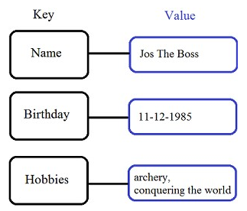
Key Value Pair Based
Data is stored in key/value pairs as hash tables with a unique key and a value
The value can be a JSON, BLOB(Binary Large Objects), string, etc
Are absolutely schemaless
Typical Examples: Redis, Dynamo,
Riak, Voldemort

Slide 44
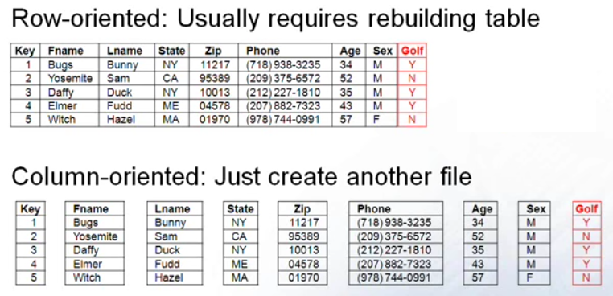
Column-based
Advantages of RDB
Search in RDB is efficient where indices such are unique
For analytical queries which scan many rows RDB isn’t efficient
For columnar DB, each row is stored in a separate file; such that, each column for a given row is at the same offset to keep the data in the different files linked.
- Only columns concerned are scanned
Limitations
Adding a column in in RDMS means restructuring the existing table/Data. In NoSQL, you just create a new file!
Not suitable for OLTP situation
Inserting/deleting a single row is faster in the case of RDMS since it’s all in same file. In the case of NoSQL, Bulk/batch insertion is the way to go.
Examples: Cassandra, HBase, Hypertable

Slide 45
Document-Oriented NoSQL Databases
Document-Oriented NoSQL DB stores and retrieves data as a key value pair but the value part is stored as a document.
The document is stored in JSON or XML formats.
Mostly used for CMS, blogging platforms, real-time analytics and
e-commerce applications.
Examples: Amazon SimpleDB, CouchDB, MongoDB

Slide 46
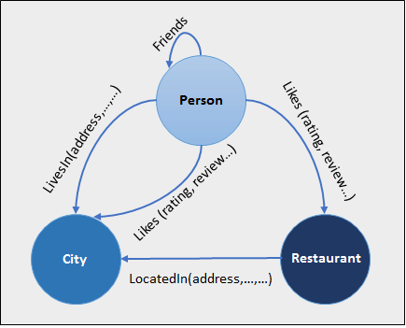
Graph Oriented NoSQL Databases
Stores entities and relations amongst them
The entities are depicted as nodes while
relationships are in the form edges
Every node and edge has a unique identifier.
Suitable for highly interconnected data such
as social networks, scientific paper citations,
logistics, spatial data, etc
Examples: Neo4J, Infinite Graph, OrientDB, FlockDB

